Slide 1
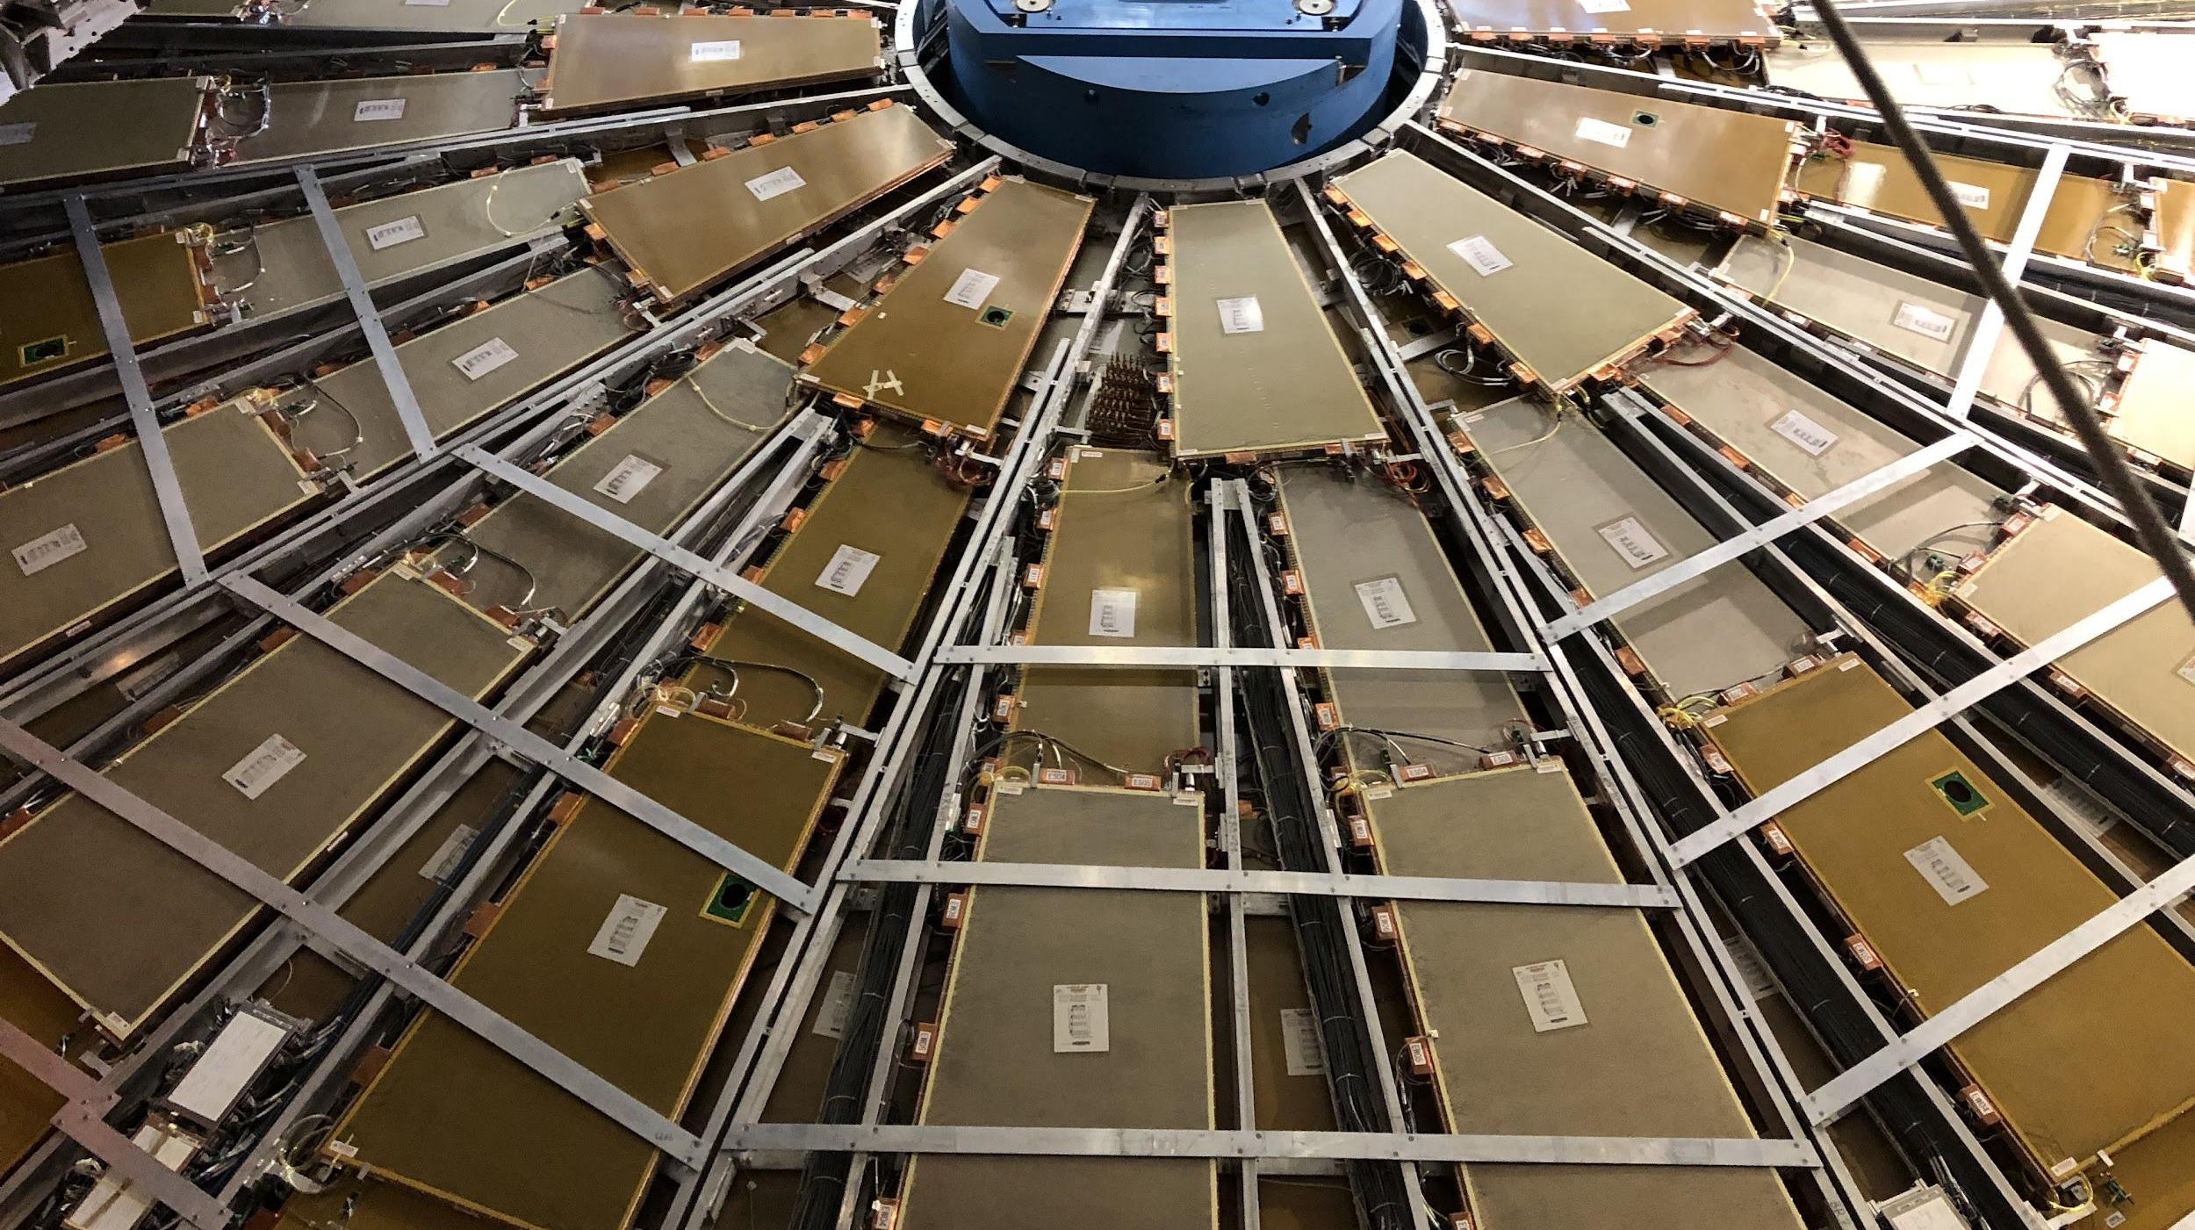

Maintenance Weekly
TileCal Op Meeting, 20 January 2022
Irakli Minashvili, Chris Thomas, Dawit Belayneh, Katie Hughes

Slide 2
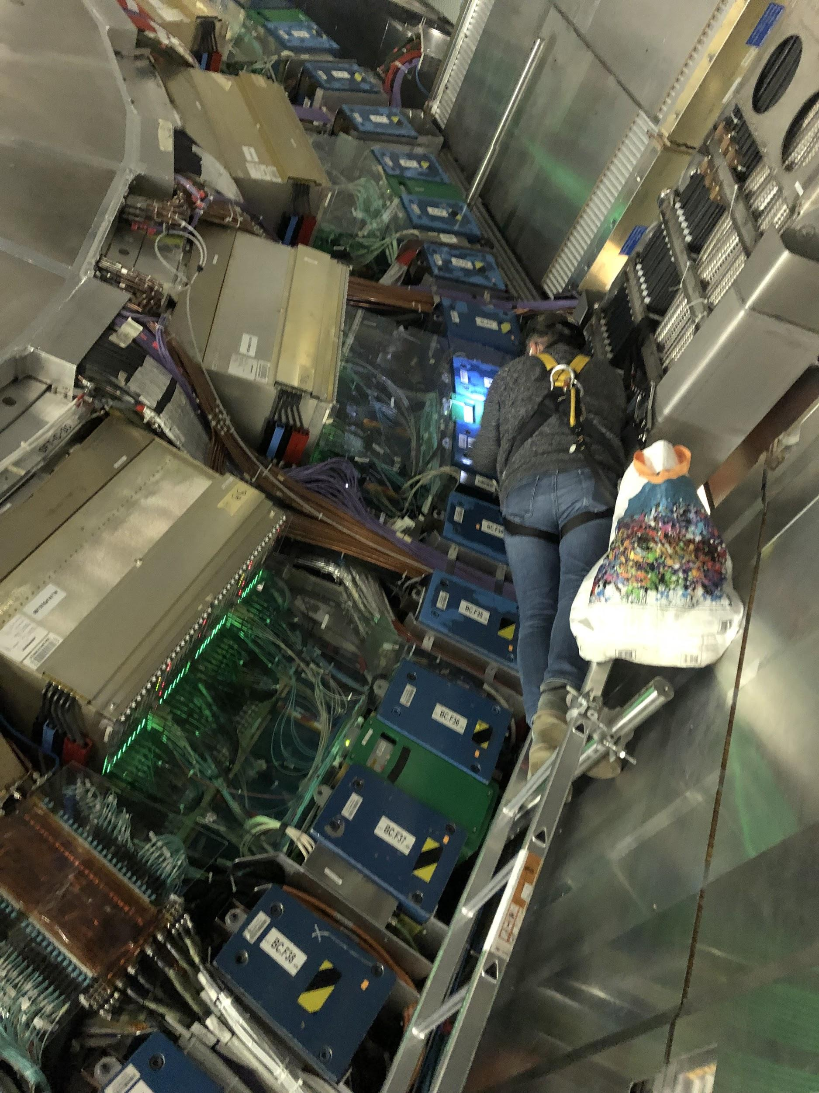
Cooling Status
LBC 33
Identified leak using air hoses
Drawer opened Jan 19
Leak location on the HV side inside of drawer, we bypassed this segment and saw huge improvement in PPV cycle
Drawer closed, current temperature is acceptable

Slide 3
Cooling Status
Loop 16
Seemed as though there were leaks in many different modules according to air hose tests with the water circulation OFF
Circulation turned back ON today and problems resolved (?)
We will not touch this loop any further
Loop 13
Leak identified in this loop with air hoses
Currently locked (?)

